Slide 1


Tuples
Chapter 10
Python for Everybody
www.py4e.com
Notes:
Note from Chuck. If you are using these materials, you can remove the UM logo and replace it with your own, but please retain the CC-BY logo on the first page as well as retain the acknowledgement page(s) at the end.

Slide 2
Tuples Are Like Lists
Tuples are another kind of sequence that functions much like a list - they have elements which are indexed starting at 0
>>> x = ('Glenn', 'Sally', 'Joseph')
>>> print(x[2])
Joseph
>>> y = ( 1, 9, 2 )
>>> print(y)
(1, 9, 2)
>>> print(max(y))
9
>>> for iter in y:
... print(iter)
...
1
9
2
>>>

Slide 3
but... Tuples are “immutable”
Unlike a list, once you create a tuple, you cannot alter its contents - similar to a string
>>> x = [9, 8, 7]
>>> x[2] = 6
>>> print(x)
>>>[9, 8, 6]
>>>
>>> y = 'ABC'
>>> y[2] = 'D'
Traceback:'str' object does
not support item
Assignment
>>>
>>> z = (5, 4, 3)
>>> z[2] = 0
Traceback:'tuple' object does
not support item
Assignment
>>>

Slide 4
Things not to do With Tuples
>>> x = (3, 2, 1)
>>> x.sort()
Traceback:
AttributeError: 'tuple' object has no attribute 'sort'
>>> x.append(5)
Traceback:
AttributeError: 'tuple' object has no attribute 'append'
>>> x.reverse()
Traceback:
AttributeError: 'tuple' object has no attribute 'reverse'
>>>

Slide 5
A Tale of Two Sequences
>>> l = list()
>>> dir(l)
['append', 'count', 'extend', 'index', 'insert', 'pop', 'remove', 'reverse', 'sort']
>>> t = tuple()
>>> dir(t)
['count', 'index']

Slide 6
Tuples are More Efficient
Since Python does not have to build tuple structures to be modifiable, they are simpler and more efficient in terms of memory use and performance than lists
So in our program when we are making “temporary variables” we prefer tuples over lists

Slide 7
Tuples and Assignment
We can also put a tuple on the left-hand side of an assignment statement
We can even omit the parentheses
>>> (x, y) = (4, 'fred')
>>> print(y)
fred
>>> (a, b) = (99, 98)
>>> print(a)
99

Slide 8
Tuples and Dictionaries
>>> d = dict()
>>> d['csev'] = 2
>>> d['cwen'] = 4
>>> for (k,v) in d.items():
... print(k, v)
...
csev 2
cwen 4
>>> tups = d.items()
>>> print(tups)
dict_items([('csev', 2), ('cwen', 4)])
The items() method in dictionaries returns a list of (key, value) tuples

Slide 9
Tuples are Comparable
The comparison operators work with tuples and other sequences. If the first item is equal, Python goes on to the next element, and so on, until it finds elements that differ.
>>> (0, 1, 2) < (5, 1, 2)
True
>>> (0, 1, 2000000) < (0, 3, 4)
True
>>> ( 'Jones', 'Sally' ) < ('Jones', 'Sam')
True
>>> ( 'Jones', 'Sally') > ('Adams', 'Sam')
True

Slide 10
Sorting Lists of Tuples
We can take advantage of the ability to sort a list of tuples to get a sorted version of a dictionary
First we sort the dictionary by the key using the items() method and sorted() function
>>> d = {'a':10, 'b':1, 'c':22}
>>> d.items()
dict_items([('a', 10), ('c', 22), ('b', 1)])
>>> sorted(d.items())
[('a', 10), ('b', 1), ('c', 22)]

Slide 11
Using sorted()
>>> d = {'a':10, 'b':1, 'c':22}
>>> t = sorted(d.items())
>>> t
[('a', 10), ('b', 1), ('c', 22)]
>>> for k, v in sorted(d.items()):
... print(k, v)
...
a 10
b 1
c 22
We can do this even more directly using the built-in function sorted that takes a sequence as a parameter and returns a sorted sequence

Slide 12
Sort by Values Instead of Key
If we could construct a list of tuples of the form (value, key) we could sort by value
We do this with a for loop that creates a list of tuples
>>> c = {'a':10, 'b':1, 'c':22}
>>> tmp = list()
>>> for k, v in c.items() :
... tmp.append( (v, k) )
...
>>> print(tmp)
[(10, 'a'), (22, 'c'), (1, 'b')]
>>> tmp = sorted(tmp, reverse=True)
>>> print(tmp)
[(22, 'c'), (10, 'a'), (1, 'b')]

Slide 13
The top 10 most common words
fhand = open('romeo.txt')
counts = {}
for line in fhand:
words = line.split()
for word in words:
counts[word] = counts.get(word, 0 ) + 1
lst = []
for key, val in counts.items():
newtup = (val, key)
lst.append(newtup)
lst = sorted(lst, reverse=True)
for val, key in lst[:10] :
print(key, val)

Slide 14
Even Shorter Version
>>> c = {'a':10, 'b':1, 'c':22}
>>> print( sorted( [ (v,k) for k,v in c.items() ] ) )
[(1, 'b'), (10, 'a'), (22, 'c')]
List comprehension creates a dynamic list. In this case, we make a list of reversed tuples and then sort it.
http://wiki.python.org/moin/HowTo/Sorting

Slide 15
Summary
Tuple syntax
Immutability
Comparability
Sorting
Tuples in assignment statements
Sorting dictionaries by either key or value

Slide 16
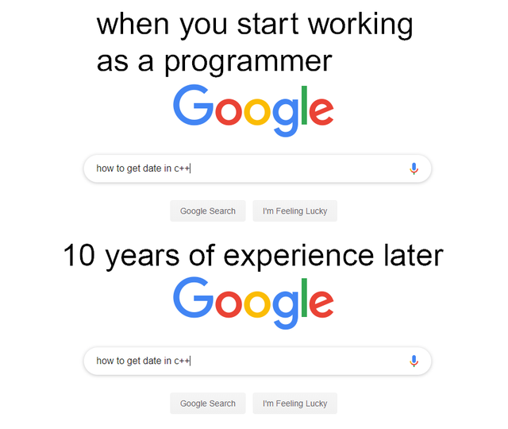

Slide 17
Eight Principles for your future learning path:
1- Passion - you are trying to find "Finding Your Element in Life“
2- Purpose - The Goal
3- Persistence, perseverance or grit - you push your way through it, persevere in that class
4- Playfulness
5- Choice - it's your personal decision to get that class and complete it
6- Commitment
7- Connections - any class is about connections, and relationships
8- Completion
by Dr. Curt (Indiana University)

Slide 19
Acknowledgements / Contributions
These slides are Copyright 2010- Charles R. Severance (www.dr-chuck.com) of the University of Michigan School of Information and open.umich.edu and made available under a Creative Commons Attribution 4.0 License. Please maintain this last slide in all copies of the document to comply with the attribution requirements of the license. If you make a change, feel free to add your name and organization to the list of contributors on this page as you republish the materials.
Initial Development: Charles Severance, University of Michigan School of Information
… Insert new Contributors and Translators here
...

